Slide 1
Popular Physics in History

Slide 2
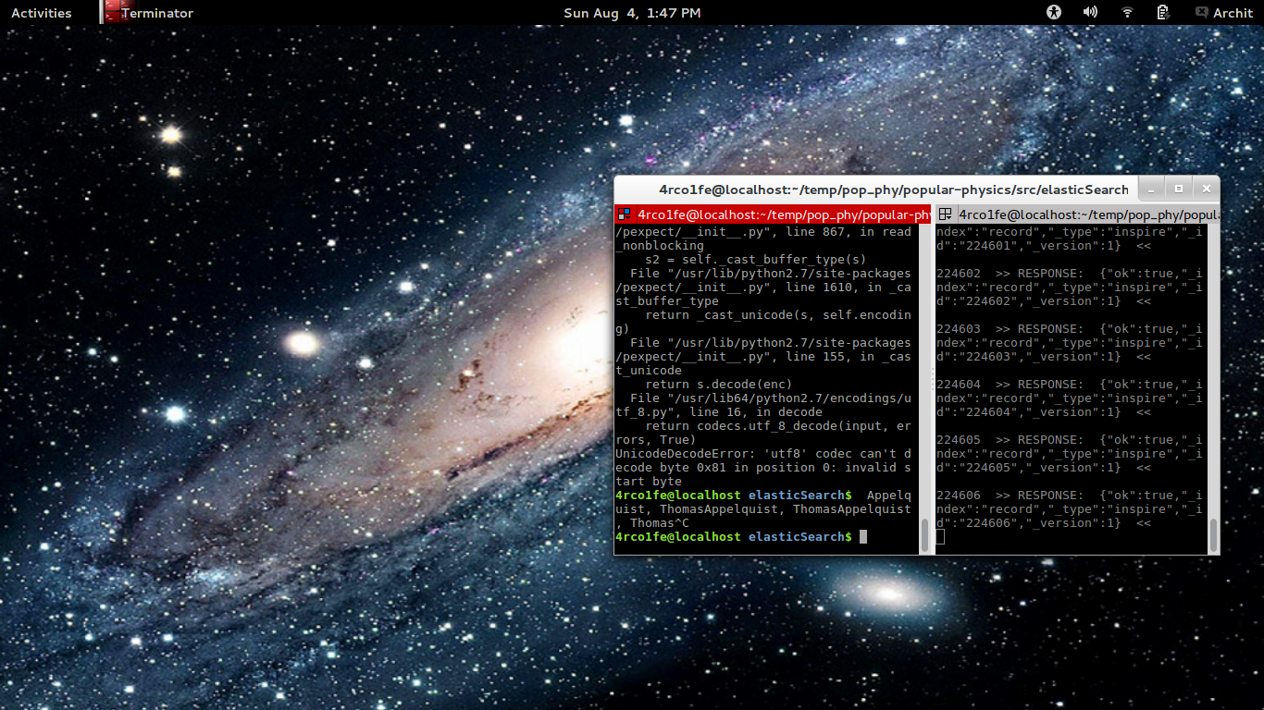

Slide 3
Yes this was the ppt i showed. :D

Slide 4
&
Thank You !
:)
Github.com/arcolife/popular-physics

